Slide 1
  Address, TSF and Account Merge
LEVEL - PRACTITIONER

Slide 2
About the Author
Created By: | Sourav Bhattacharjee, Prashant Prashant, Supriyo Saha
Credential Information: | Associate – Projects; Sr. Consultant CRM – EAS Salesforce
Version and Date: | V1: 24-Jan-2018, V1.1: August-2023: Updated with Lightning UI
Modified By: | Abhijan Majumdar

Slide 3
Recap ...
In the previous Module - Sphere of influence, Affiliation, Account Hierarchy, you learnt to ...
  Track Parent-Child relationships through Account Hierarchy
  Display Affiliations (account) through Sphere of Influence in an intuitive graphical format
And now ...

Slide 4

Do You Know
When primary type custom fields are managed by users, the primary setting does not move from the object unless it is changed by a user
For example, a sales rep might not get compensated for sampling a doctor if VEEVA OpenData inactivates an address and Network automatically recalculates and moves the primary address to another state or province in the same fiscal quarter
Now, customers can choose whether a primary field is managed by Network or managed by users
You can’t merge person accounts that are enabled to use portal or community users

Slide 5

Overview
In life sciences industry every doctor, pharmacy, hospital, medical institution is treated as an account and broadly categorized as
  Person accounts
  Business accounts
Each of these accounts have an associated address. These physical address/addresses are often segregated into various logical groups/territories
In this module we will discuss about
  The objects that are used to hold the address, territory
  Related information about the accounts & account merge functionality

Slide 6

Objectives
After completing this chapter, you will learn to:
  Define & describe VEEVA Address, its specific fields & type, some sample rules
  Identify the objects used to hold a new Address, Territory Specific Fields(TSF), VEEVA managed attributes for TSF and TSF configuration
  Describe the account merge functionality used to merge two or more duplicate accounts in order to maintain proper data

Slide 7
Address

Slide 8
Address: Overview
Addresses in VEEVA, enable users to maintain multiple addresses for each Person or Business Account
  Every account can have one or more address associated with it
  In case an account has more than one address then one of the addresses of account is marked as “Primary” or “Preferred” of the account
  Addresses can also be used in the Reports or Order management modules where we can denote an address as billing or shipping address of an order
  State License Fields and DEA License Fields exist on the Address object that store State and DEA license. VEEVA supports US and Canadian state licenses

Slide 9
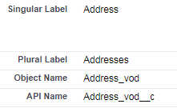
Address Object details Part 1
The Address information in VEEVA is stored in the object named Address_vod
Address_vod is a child object of the Account object within a Master-Detail relationship, where Account is on the master side and Address_vod on the detail side
Each address is stored as a separate record
Address records are displayed in account page layout related list
Address_vod object is supported by below VEEVA CRM platforms
  Online
  CRM for iPad
  Windows 10

Slide 10
Address Object details Part 2
The Address object in VEEVA has two record types:
  Company Maintained: These are the master data for the organization, and sales reps are not allowed to modify this data
  Rep Maintained: Sales reps create and manage this type of data on their own. This data helps them to record call and sampling for other addresses than present in organization master data
One account can have multiple addresses associated with it:
  One of those address needs to be marked as ‘Primary’:
    This is needed for territory alignment
  One of those address needs to be marked as ‘Preferred’:
    This is to be done from territory specific field
    This is the last used address on a call for the account

Slide 11
Primary vs Preferred Address
Primary Address
This address is displayed in My Accounts tab when no Preferred Address exists
This address applies to the Account and this is not territory specific
This is defined by Primary checkbox (Primary_vod__c)
This is used for territory alignment
Preferred Address
This address is displayed by default in My Accounts tab
This is Territory-Specific. Only one territory specific field can be there for a territory, for an account
This is defined by preferred field in TSF object
This address is defaulted in call picklists
Trigger on call object maintains this information based on last address used on a call

Slide 12
Key Address Fields
Inactive
Provides a mechanism to filter addresses available for selection on a Call Report and in My Schedule
If checked then Address record will not be displayed in Call creation page and My Schedule
Address object Inactive_vod__c field is being used for this purpose
Lock
Provides organizations with a mechanism to prevent an Address from being edited or deleted by an end user
If checked user cannot edit or delete the Address Line 1 (Name) field online and makes the field read only in offline devices
Address object Locked_vod__c field is being used for this purpose

Slide 13
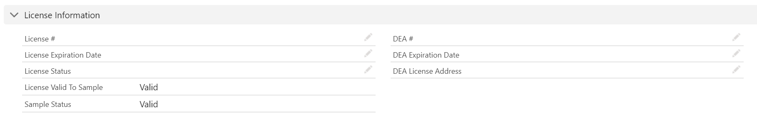
Address Sample Rules
DEA and State License info stored on Address object:
VEEVA stores state license information in Address object. VEEVA CRM supports US and Canada state license
An Apex trigger on address object ensures license information is shared with various address under same account:
  US: License is copied to all address in same state, when a new address is created
  Canada: License information is copied to all address for same account
  For address license information update, all related fields will be automatically updated for all addresses in same state

Slide 14
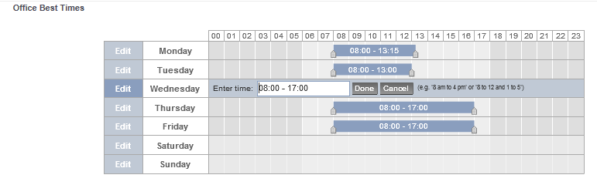
Office Best Time
Office Best time is stored in VEEVA Address object
VEEVA provides scheduling functionality with office best times
  It highlights the best time in my schedule and inserts the call record accordingly
Configuration for Office Best Times:
  Place the Office Best Times s-control on the Address page layouts
  Give user profiles FLS access to the Best_times_vod field in the Address_vod__c object
Provide best times values for address
  Users are allowed to enter best time values from both online or offline using CRM (iRep) or load data for them

Slide 15
Territory Specific Fields

Slide 16
Territory Fields: Overview
Territory Specific Field information is stored in Territory Field (TSF_vod) object. For each account and for each territory VEEVA maintains a TSF record to track activities
Territory Field information is used to track the following:
  YTD Activity - The YTD total number of recorded calls
  Last Activity Date - The most recent date a call was made to the account for the given territory (excluding “Planned” calls)
  My Preferred Address - The last address used on a call. This address is displayed by default in My Accounts tab
The YTD Activity, Last Activity Date and My Preferred Address fields on the Territory Field object are updated by a trigger on the Call object
When the TSF records are created, the TSF Name field populates with the Territory ID. Users can change the name

Slide 17
VEEVA-Managed Attributes
A TSF record is automatically created for each territory the Account is aligned to:
  After creating a Call on an Account
  During a mass update of a TSF field
YTD Activity and Last Activity Date TSF fields are updated as per following logic, by a VEEVA trigger on call object:
  Last Activity Date is set to the value of the call date
  YTD Activity is incremented by one
  Only Saved or Submitted Calls for that Account with date/time prior to the current date/time are counted
TSF Address field is updated with the most recently saved address selected on the call record for the account:
  This one uses My Preferred Address field

Slide 18
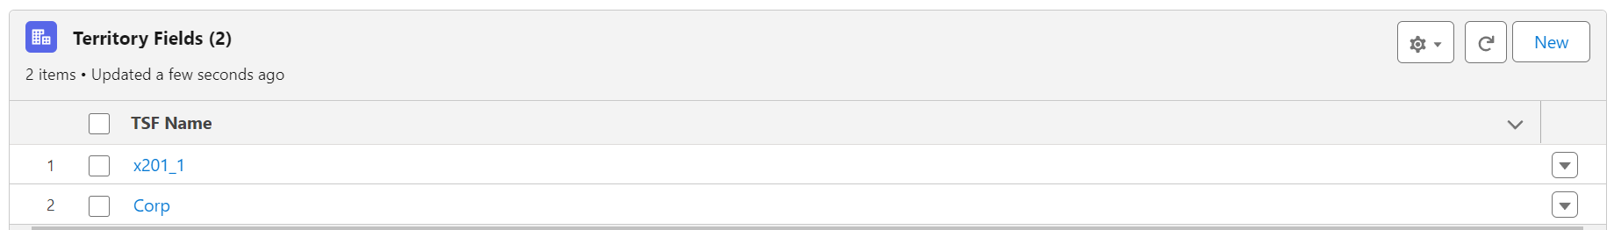
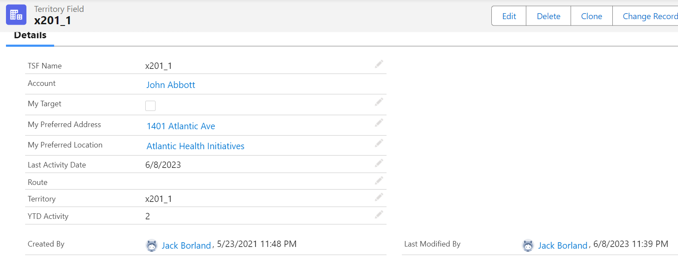
Territory Specific Fields from Account
VEEVA Admin can configure to show Territory Specific Fields information on Accounts page layouts by using:
  Account Territory Info s-control
  TSF visual force page
TSF Information as related list from Account page layout
For user to see the TSF details in account inline page layout

Slide 19
Territory Specific Fields Configuration
Record types are supported on TSF object. Admin may need to configure TSF object to meet the following requirement:
  View different TSF page layouts based on type of Account being viewed
  Available online and offline
Admin will have to make the following changes to meet the requirement:
  Create a TSF record type and page layouts with a name that matches the record type name of associated account
    If Account record type name = Professional
    Then TSF record type name = Professional
Following TSF fields are not by default displayed on Account page layout
  Created By
  Last Modified By
  Account
  Territory_VoD

Slide 20
Territory Fields - Pre-Requisites
In order to utilize Territory Fields within the VEEVA CRM application, the following is required:
  Territory Management must be enabled and established within the org
    Territory Management Rules
    Manual assignment
  Users must have Read/Create/Edit access to the Territory Field object
  Users must have Read access to the Address object

Slide 21
Account Merge

Slide 22


Account Merge: Overview
VEEVA admin can merge duplicate accounts to maintain proper data. Up to 3 accounts can be merged in to one account
Apart from Accounts, VEEVA extends the SFDC Account Merger process on below mentioned objects:
  Territory Specific Fields
  Address
  Call
  Sample Limits and Sample Limit Transactions
  All other object in Master-Detail relationship with Account
Note:
It is not possible to merge business account with person account or vice versa.
Bob Smith
Bobsmith
Bob Smith

Slide 23
VEEVA Account Merge
VEEVA Administrators can use the standard SFDC Accounts tab to merge Accounts
  VEEVA end users should not be having access to the standard ‘Account’ tab and the associated
  standard Salesforce tools. They should use VEEVA ‘My Accounts’ tab instead
Admin can also use custom account merge functionality. They will have to deactivate the VEEVA account merge functionality first for the same. Admin will have to perform the following for that purpose:
  Setup → Create → Custom Labels
  Set DISABLE_VEEVA_MERGE_vod Custom Label = True
When admin merge accounts with different account hierarchies, the losing account’s account hierarchy is removed. Admin can also configure to delete the inactive target records of the losing account after successful merge of the active targets with winning account

Slide 24
Account Merge: Address
  The address merge behavior while merging Account, can be controlled by Custom label: ACCOUNT_ADDRESS_MERGE_BEHAVIOR., which has the following options/settings
INACTIVE
Default value
Copies all addresses from the losing Account as Inactive
Inactive flag = true for these records
Administrator can later change address to Active upon verification
ACTIVE
Copies all addresses from losing Account, as ACTIVE
Inactive flag = false for these records
ASIS
Default Salesforce.com merge behavior in which Addresses are copied over to the winning Account
Inactive flag = same value as before the merge

Slide 25
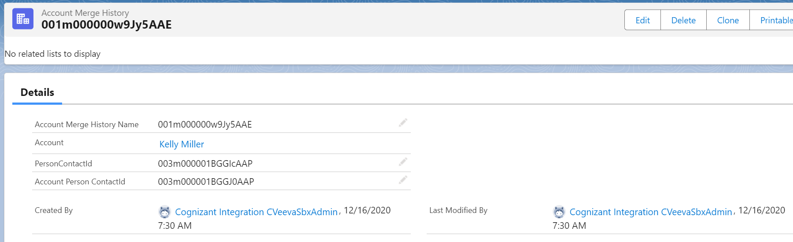
Account Merge History
VEEVA maintains the history of the merges for any account in Account Merge History (Account_Merge_History_vod) object
  Admin can configure the Account merge history to be shown as the related list
The ‘Account Merge History Name’ field shows the SFDC Id of the looser account

Slide 26
Account Merge: Call
If the user has already synced offline device, and the call is present online for the losing
account, these calls will be migrated to the winner account
Offline device users can sync calls linked with a loser account. The calls will be automatically migrated to the winning Accounts upon successful synchronization
VEEVA admin need to configure the following for synchronization of offline device calls on looser account:
  The offline user Profile needs to have READ permission for the Account_Merge_History_vod object
  The offline user needs to have an ACTIVE VMOC for the Account_Merge_History_vod object to access the data from their respective devices

Slide 27
Account Merge: Territory Specific Field
Territory Specific Field information is stored in Territory Field (TSF_vod) object. For each
account and for each territory VEEVA maintains a TSF record to track activities. The TSF record maintains – My Preferred Address, YTD Activity, Last Activity Date
Things to consider in Territory Specific Field (TSF_vod) object records while merging 2 accounts:
  If a Territory Specific Field (TSF) record exists for the losing Account but not for the winning account
    The losing Account’s TSF record will be copied to the winning Account
  If a TSF record exists for both the winning as well as loosing account
    The losing Account’s TSF record will be deleted
Note:
This feature is non-configurable if the VEEVA Account Merge processing is being used

Slide 28
Account Merge: Account Territory Loader
The Account Territory Loader (ATL) is used for Territory management. The New Account and New Record Type wizards create ATL objects when a user creates Accounts. The wizards also perform a Territory realignment for the current user
Things to consider in Account Territory Loader (ATL_vod) object records while merging 2 accounts-
  The winner account gets aligned to the territories to which the losing account was aligned to
  The duplicate territories will be removed and the ATL Territory field will display a particular territory only once
  The ‘ATL’ record of the losing Account gets deleted
  TO disable VEEVA specific merge process, DISABLE_VEEVA_MERGE_vod label must be set to TRUE

Slide 29
How to “Unmerge” Accounts
Admin need to be cautions before they merge any accounts, as there is no Unmerge button!
If two Accounts are merged through the UI with VEEVA Merge with an incorrect winning account selected, then VEEVA admin should perform the following:
  Go to the Recycle Bin and "undelete" the Account deleted via the merge
  Merge the two Accounts again – be sure to select the correct winning account
  Check to make sure all related data looks correct in the winning account detail page
VEEVA admin will need to pay attention to the addresses as they will all likely be set to “Inactive”

Slide 30
Check Your Understanding 1
Admin can configure to disable VEEVA account merge functionality?
TRUE
FALSE
Answer: TRUE
© Cognizant 2023

Slide 31
Check Your Understanding 2
State license fields exist on the address object
VEEVA supports all US state licenses except TEXAS
TRUE
FALSE
Answer: FALSE
© Cognizant 2023

Slide 32
Check Your Understanding 3
Choose which of the following is/are true about relationship between Address objects and Account objects
Account object is the master and address is in the detail
Address object is the master and account is in the detail
None of the above
Address_Vod is the child object of the account object
Answer: Account object is the master and address is in the detail,
Address_Vod is the child object of the account object
© Cognizant 2023

Slide 33
Check Your Understanding 4
Which of the following TSF fields are not displayed by default on the Account page layout?
YTD activity
Created by
Last Modified By
MY preferred Address
Answer: Created by, Last Modified By
© Cognizant 2023

Slide 34
Check Your Understanding 5
During the account merge activity, the INACTIVE FLAG = ‘same as what it was before’ is for which type
INACTIVE
ASIS
both
Answer: ASIS
© Cognizant 2023

Slide 35
Check Your Understanding 6
During the Account merger activity which of the below statements about TSF record handling is/are TRUE
If TSF record exists for the losing account and does not exist for winning account, the losing account TSF record is deleted
If TSF record exists both for the winning account and losing account, the losing accounts TSF record will be deleted
If TSF record exists both for the winning account and losing account, both are merged
Answer: If TSF record exists both for the winning account and losing account the losing accounts TSF record will be deleted
© Cognizant 2023

Slide 36

Summary
In this module, you have learnt to:
Define and describe VEEVA Address, its specific fields & type
Identify the objects used to hold a new Address, Territory Specific Fields(TSF), VEEVA managed attributes for TSF and TSF configuration
Describe the account merge functionality used to merge two or more duplicate accounts in order to maintain proper data

Slide 37

Source
https://crmhelp.veeva.com/doc/Content/Home.htm
https://trailhead.salesforce.com/en/home
Disclaimer: Parts of the content of this course is based on the materials available from the Web sites and books listed above. The materials that can be accessed from linked sites are not maintained by Cognizant Academy and we are not responsible for the contents thereof. All trademarks, service marks, and trade names in this course are the marks of the respective owner(s).

Slide 38
Coming Next.
In the upcoming module - My Schedule, Calendar you will learn to do scheduling using,
  My Schedule Calendar
  SFDC Calendar

Slide 39
Thank you
  You have successfully completed
  Address, TSF and Account Merge

